Slide 1
Stock Classes in Code
Presented by: Tommy Rinehart
CEIS150

Slide 2
Within this class , I learned different methods of creating a stock class and learning to use it to bring in stock information. Within the slides will show the processes of each individual step of learning and creating stock classes and methods to use when keeping stock organized through coding.

Slide 3
In week 1, we just typed in some coding to run and tested it out to ensure our programming tool was working properly. To ensure this we used methods of different prices and figuring out how many of the other prices were more and how to get a sum of different prices given in the code.

Slide 4
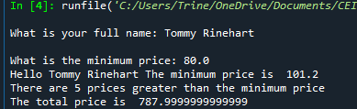
Program
Screen shot of Python program running successfully.

Slide 5
Week 2 began to test our understanding of coding stock classes. It started by creating a class diagram using different variety of methods. After creating the diagram then came the coding and putting the first class for the stock project into code.

Slide 6
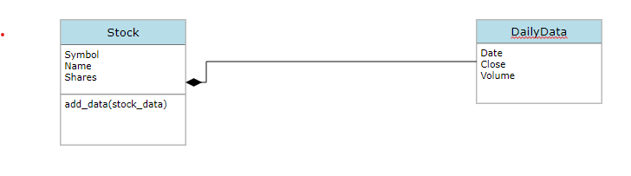
Class Diagram
Paste your Visio Class Diagram

Slide 7
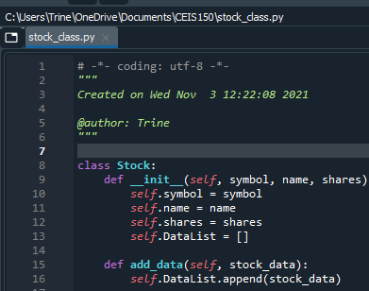
Class Code
Screen Shot of your stock_class.py file.

Slide 8
As I rolled into week 3, the next step was inputting code to add stock to our stock class, making a stock list with the different stocks that were added, and adding daily data of stock to show values of the stock.

Slide 9
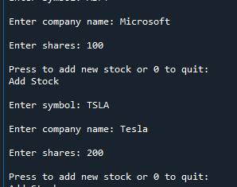
Adding a Stock
Paste a screen shot of your working Stock program.

Slide 10
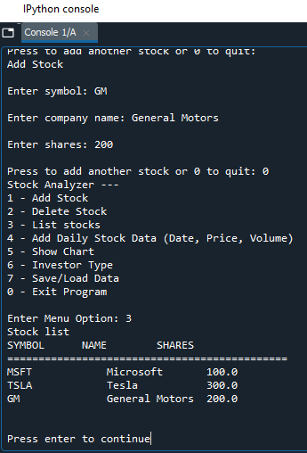
Listing 3 Stocks
Paste a screen shot of your working Stock program.

Slide 11
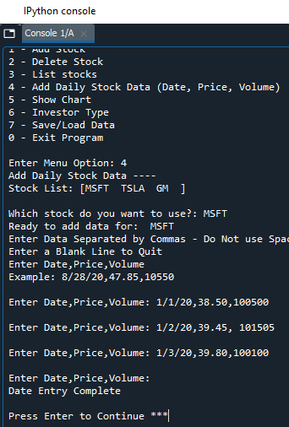
Daily Data
Paste a screen shot of your working Stock program.

Slide 12
Halfway done with the class, week 4 presented inheritance class and a retirement class that was added into code and thus presented more data for the initial stock class.

Slide 13
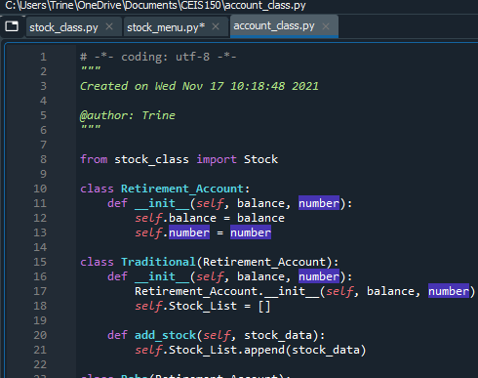
Inherited classes
Paste a screen shot of your classes

Slide 14
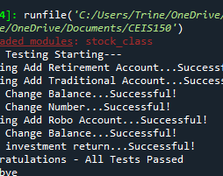
Unit Tests
Paste a screen shot of your unit tests successfully completed

Slide 15
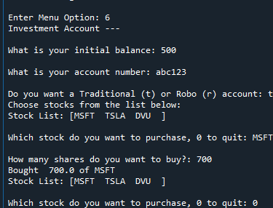
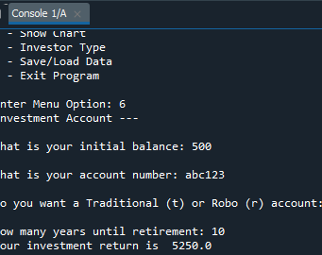
Stock menu program
Paste a screen shot of your classes in the main program

Slide 16
Week 5, I learned to use the data inputted to create a chart showing the different days and prices that the stock was at in order to help understand when would maybe be a good time to sell or to see if the pattern would continue the way it is in order to take a bigger risk if the price was increasing.

Slide 17
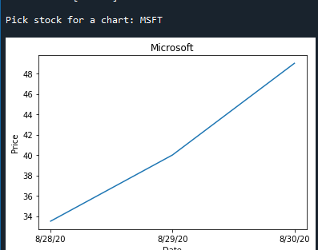
Chart
Paste a screen shot of your stock chart.

Slide 18
Going into week 6, the next process of coding was learning to save data, load it back into the program, and importing data from other places and using it with the stock class to add the daily data to the required stock.

Slide 19
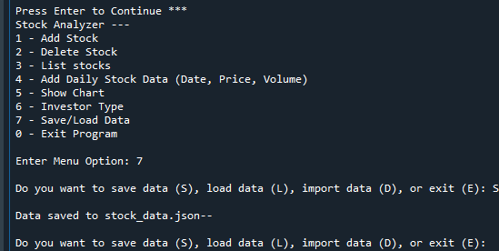
Saving Data
Paste a screen shot of the data saved to a file

Slide 20
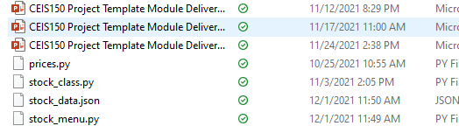
File
Paste a screen shot of the file created in file explorer

Slide 21
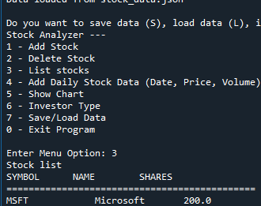
Loading Data
Paste a screen shot of stock listing

Slide 22
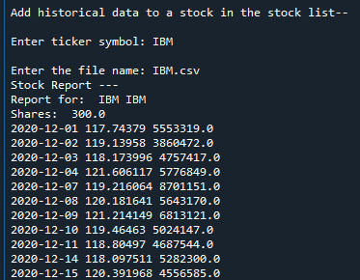
Importing data
Screenshot of the historical data import

Slide 23
Lastly, in week 7 the process was to learn how to add and delete stocks in GUI(Graphical User Interface) and import the previous daily data for the required stock. The final steps was using the imported data to make a graph and make a record of the lowest price, highest price, and average price along with the volume and the change in the price.

Slide 24
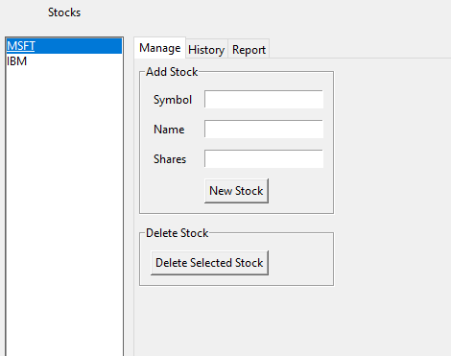
Stocks in GUI
Paste a screen shot of your GUI working

Slide 25
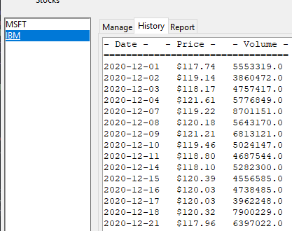
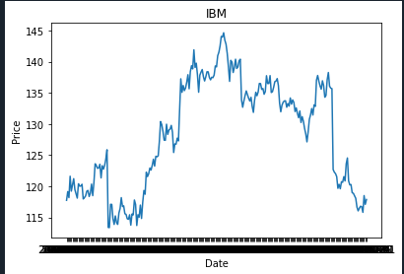
History Tab
Paste a screen shot of your History tab with import working.

Slide 26
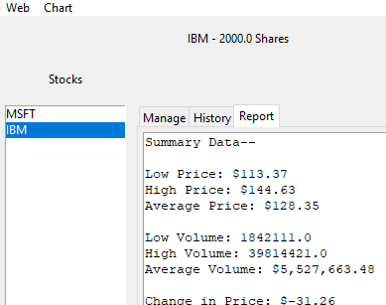
Report Complete
Paste a screen shot of your Report tab

Slide 27
Career Skills developed
Programming classes with code
Importing data from outside sources into code
Adding and deleting stock in code
Adding daily data values of stock
Saving and loading data through code
Different methods of creating graphs through imported data in program

Slide 28
Conclusion
This class was very helpful for me as it will be for anyone who takes this class in the future. It will teach them a lot on programming and coding. Thank you for taking your time and showing interest in my project.

